Slide 1




ISA 401: Business Intelligence & Data Visualization
15: Fundamentals of Data Visualization
Fadel M. Megahed, PhD
Raymond E. Glos Professor in Business Farmer School of Business
Miami University
@FadelMegahed fmegahed fmegahed@miamioh.edu
Automated Scheduler for Office Hours
Fall 2025

Slide 2
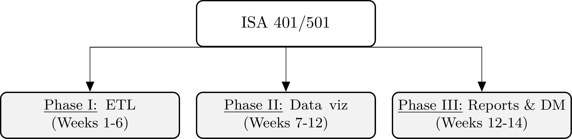
Refresher: Organization of this Course
How the ISA 401/501 course is organized.

Slide 3
Learning Objectives for Today's Class
Explain the concept of "graphical excellence"
Explain the theory of data graphics
Optimize visual encoding based on data types
Understand why color should be used sparingly and how to select appropriate colors (when color is a must)

Slide 4
GGrraapphhiiccaall EExxcceelllleennccee
44 // 3344

Slide 5
05:00
Non-graded activity: Terrible Charts
Activity Russia's Defense Budget White House Economy Growth Tucker Carlson
Over the next 5 minutes, please identify the 1-2 main problems in the charts in the
following tabs.
Write down your answers in the editable area of each chart.
Discuss your answers with your neighboring classmates.
Be prepared to share these answers with class.
5 / 34

Slide 6
Graphical Excellence: What should Graphs Do?
Show the data
Lead to thinking about the substance rather than something else
Avoid distorting what the data have to say
Present many numbers in a small space
Make large datasets coherent
Encourage the eye to compare different pieces of the data
Reveal the data at several levels of detail, from a broad overview to the fine structure
Serve a purpose: description, exploration, tabulation, decoration
Be closely integrated with the statistical & verbal descriptions of the data
Source: Tufte, E. R. (2001). The visual display of quantitative information. Cheshire, Conn: Graphics Press, P. 13.
6 / 34

Slide 7
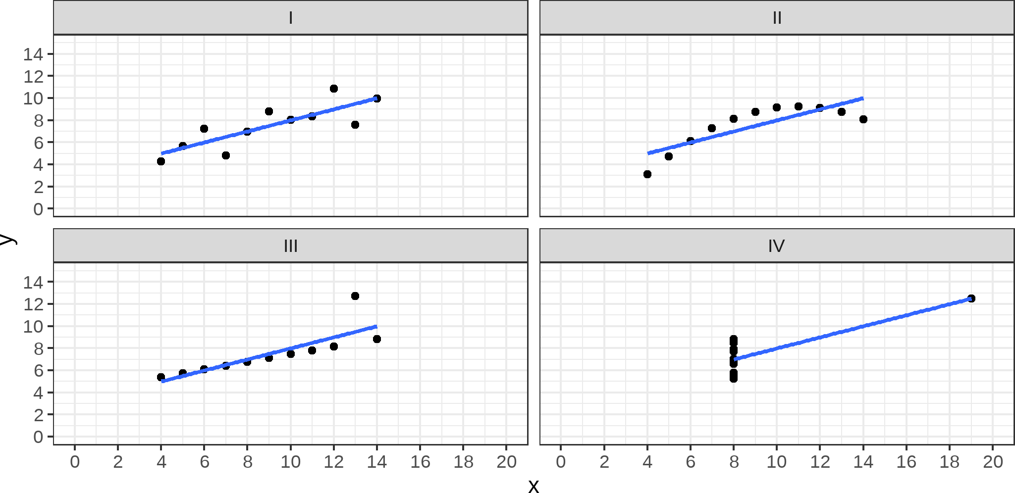
Show/Reveal the Data: Anscombe's Dataset

Slide 8
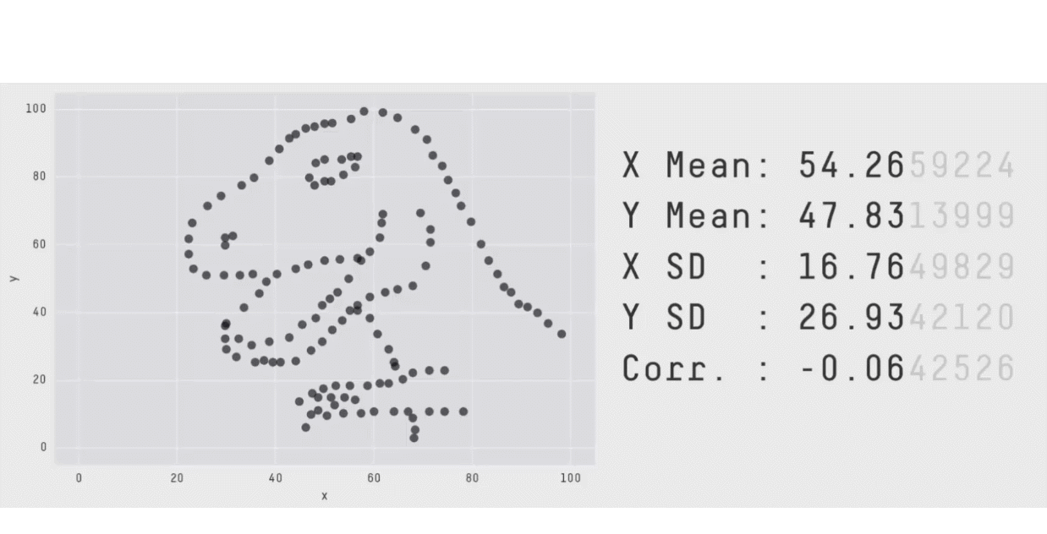
A Modern Version of Anscombe's Dataset

Slide 9
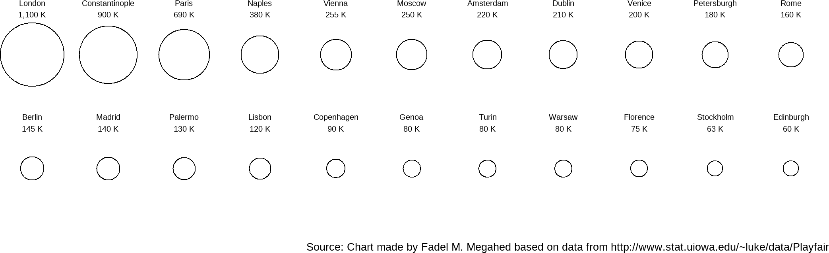
05:00
Substance
Activity Your Solution My Solution
In 5 minutes, please sketch a better (non-bubble) chart than the one use by William
Playfair for plotting the populations of 22 European cities at the end of the 1700s.

Slide 10
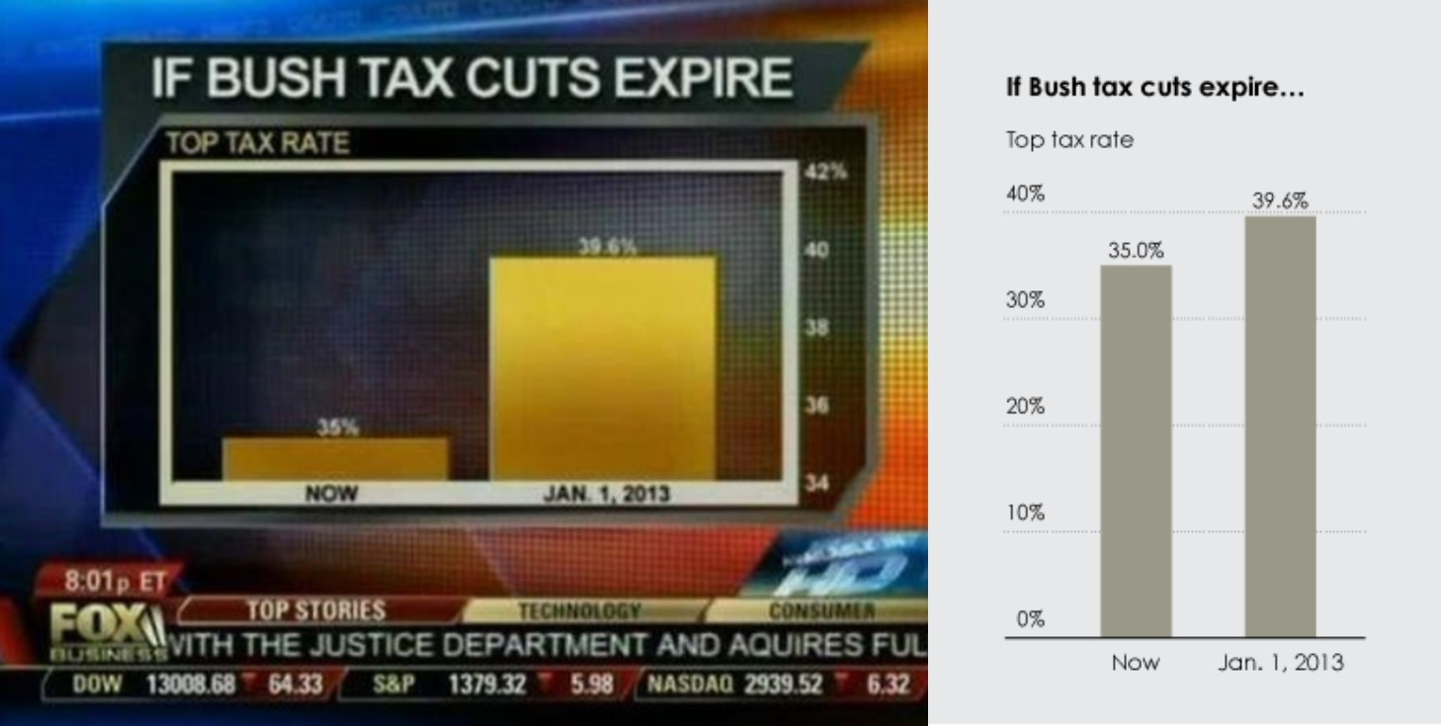
Avoid Distortion of Data
Source: Nathan Yau (2012). Fox News continues charting excellence.
10 / 34

Slide 11
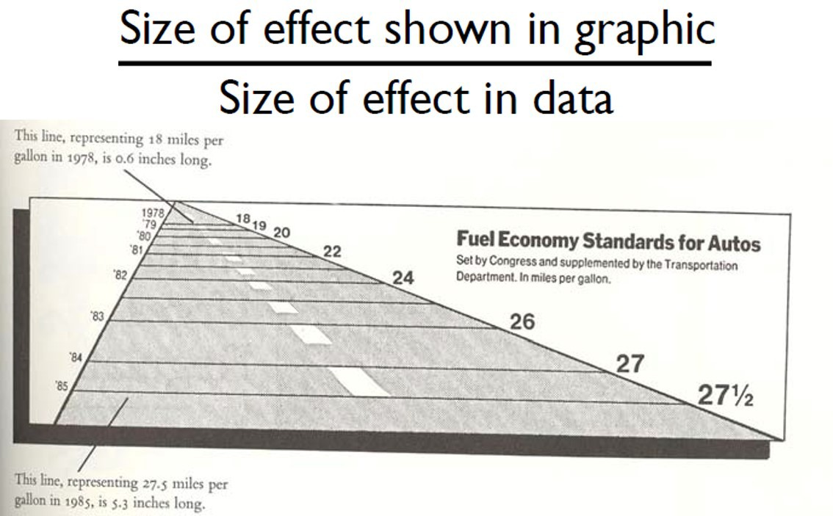
Avoid Distortion of Data: The Lie Factor
Source: Graph from Tufte, E. R. (2001). The visual display of quantitative information. Cheshire, Conn: Graphics Press, P. 57.
11 / 34

Slide 12
Graphical Integrity Principles: A Summary
Clear, detailed, and thorough labeling and appropriate scales
Size of the graphic effect should be directly proportional to the numerical quantities (“lie factor”)
Show data variation, not design variation
12 / 34

Slide 13
TThheeoorryy ooff DDaattaa GGrraapphhiiccss
1133 // 3344

Slide 14
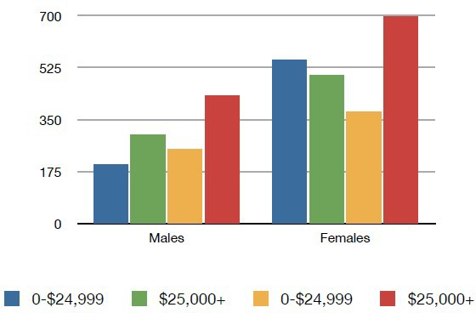
Definition of Data Ink
Data-ink refers to the non-erasable ink used for presenting the data.
If data-ink would be removed from the image, the graphic would lose the content.
Source: Slide Adapted from Hanspeter Pfister. Lecture Notes for CS 171. Harvard University. http://cs171.org/
14 / 34

Slide 15
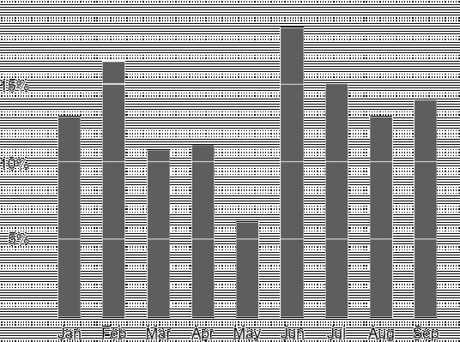
Focus on Data: Avoid Chartjunk
Chartjunk is the extraneous visual elements that distract from the message!!
Source: The image is from The Data-Ink Ratio Example
15 / 34

Slide 16
Other Subjective Design Principles
Aesthetics: Attractive things are perceived as more useful than unattractive ones
Style: Communicates brand, process, who the designer is
Playfulness: Encourages experimentation and exploration
Vividness: Can make a visualization more memorable
Source: Slide Adapted from Hanspeter Pfister. Lecture Notes for CS 171. Harvard University. http://cs171.org/. Information is based on comments by Pat Hanrahan in November 2007. Those can be found at http://www.perceptualedge.com/blog/?p=199
16 / 34

Slide 17
DDaattaa MMooddeellss
1177 // 3344

Slide 19
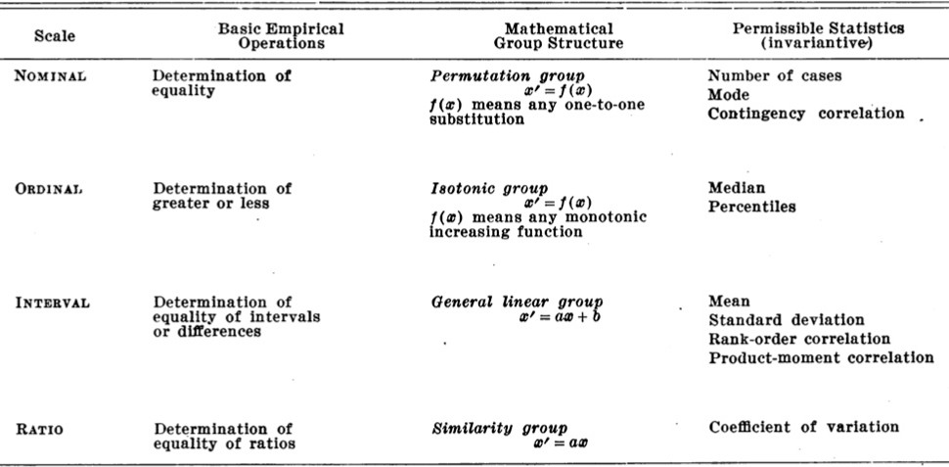
Data Types (from S. Stevens, Theory of Scales)

Slide 20
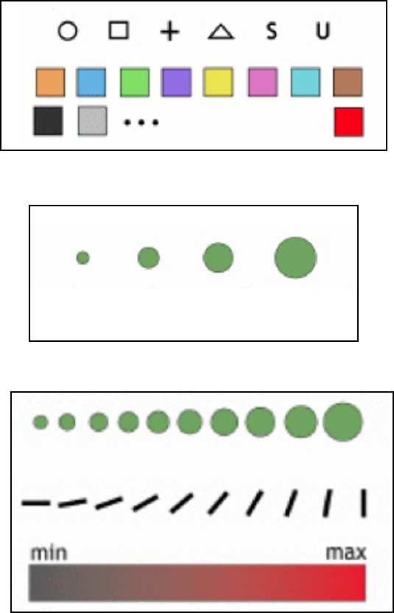
Data Types: Explained
Nominal:
Are = or ≠ to other values
Apples, bananas, oranges, etc.
Ordinal:
Obey a < relationship
Small, medium and large
Quantitative:
Can do math on them
50 inches, 53 inches, etc.

Slide 21
Quantitative Data Types (from S. Stevens)
Quantitative data can be further divided into:
Intervals (Location of Zero Arbitrary):
Dates: Jan 19; Location: (Lat, Long)
Only differences (i.e., intervals) can be compared.
Ratio (Zero Fixed):
Measurements: Length, Weight, ...
Origin is meaningful, we can compute ratios, proportions, differences, etc.

Slide 22

02:00
Non-Graded Activity: Data Terminology
Activity Your Solution
In 2 minutes, please identify an appropriate data type for each column below.
Order ID ▲ ▼ | Order Date | ▲ Order Priority ▼ | ▲ Product Container ▼ | ▲ Product Cost ▲ ▼ ▼ | Ship Date ▲ ▼
1 | 1/1/2022 | 5 - low | Large box | 25 | 1/5/2022
2 1/4/2022 4 - not specified Small Box 36 1/7/2022
3 | 1/15/2022 | 2- high | Small Box | 38 | 1/17/2022
3 1/15/2022 2- high Small Box 41 1/17/2022
3 | 1/15/2022 | 2- high | Jumbo Box | 44 | 1/17/2022
3 1/15/2022 2- high Wrap Bag 33 1/17/2022
4 | 1/18/2022 | 1- urgent | Small Box | 33 | 1/19/2022
Showing 1 to 7 of 11 entries
Previous
1
2
Next

Slide 23
Data vs. Conceptual Models
From data model
32.5, 54.0, -17.3, ...
Using a conceptual model:
Temperature
To data type:
Continuous to x significant digits i.e. quantitative
Hot, warm, cold i.e. ordinal
Burned vs. not burned i.e. nominal

Slide 24
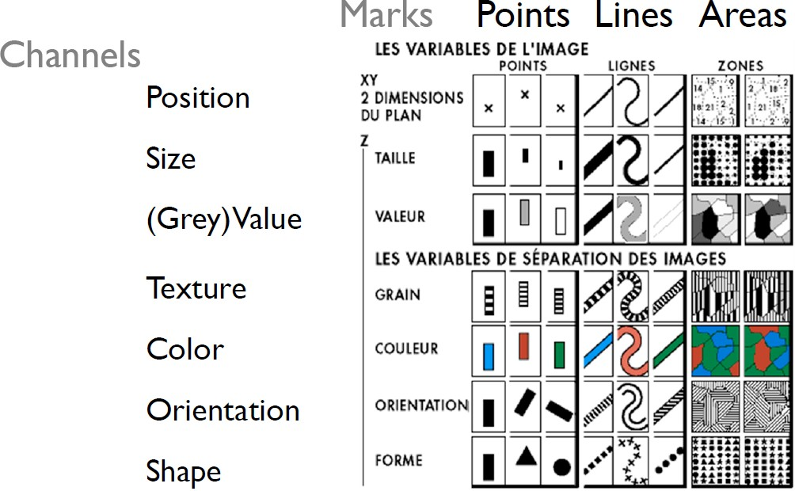
Image Model: Visual (Encoding) Variables
Source: Bertin (1967), Seminology of Graphics.
24 / 34

Slide 25
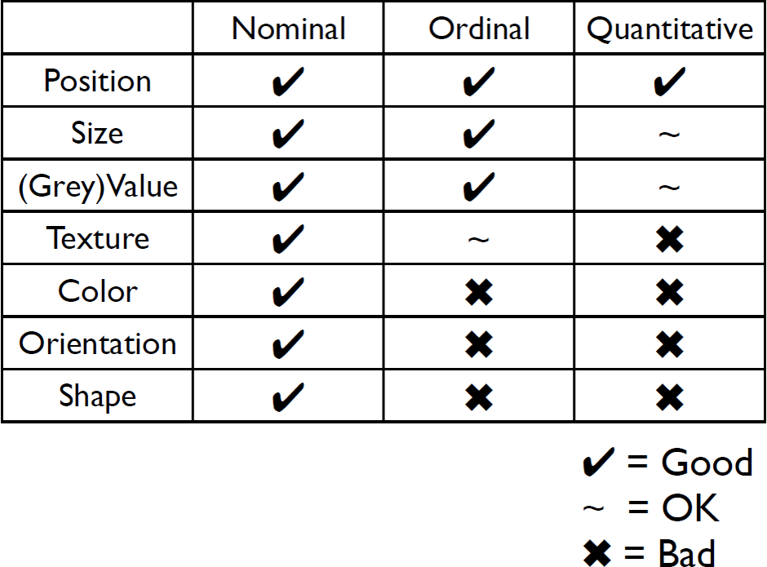
Mapping to Data Types
Source: Slide Adapted from Hanspeter Pfister. Lecture Notes for CS 171. Harvard University. http://cs171.org/
25 / 34

Slide 26
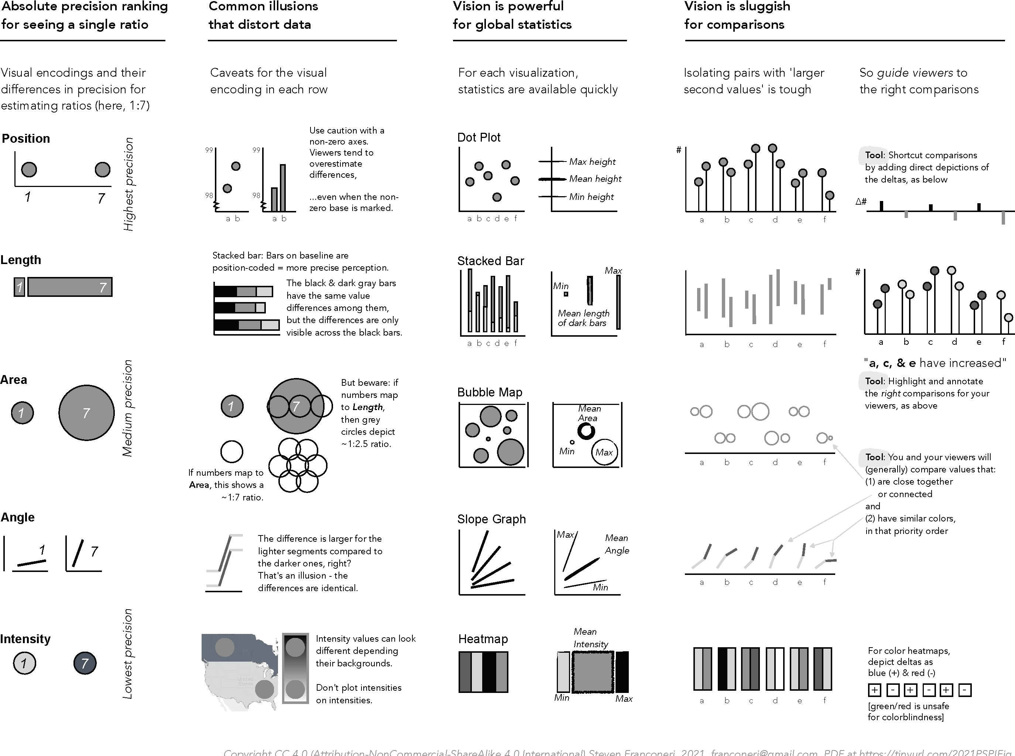
Visual Channels and their Precision
Source: Franconeri, et al. (2021). The Science of Visual Data Communication: What Works. To view the full size image, click here.
26 / 34

Slide 27
CCoolloorr SShhoouulldd BBeeUUsseedd SSppaarriinnggllyy
2277 // 3344

Slide 28
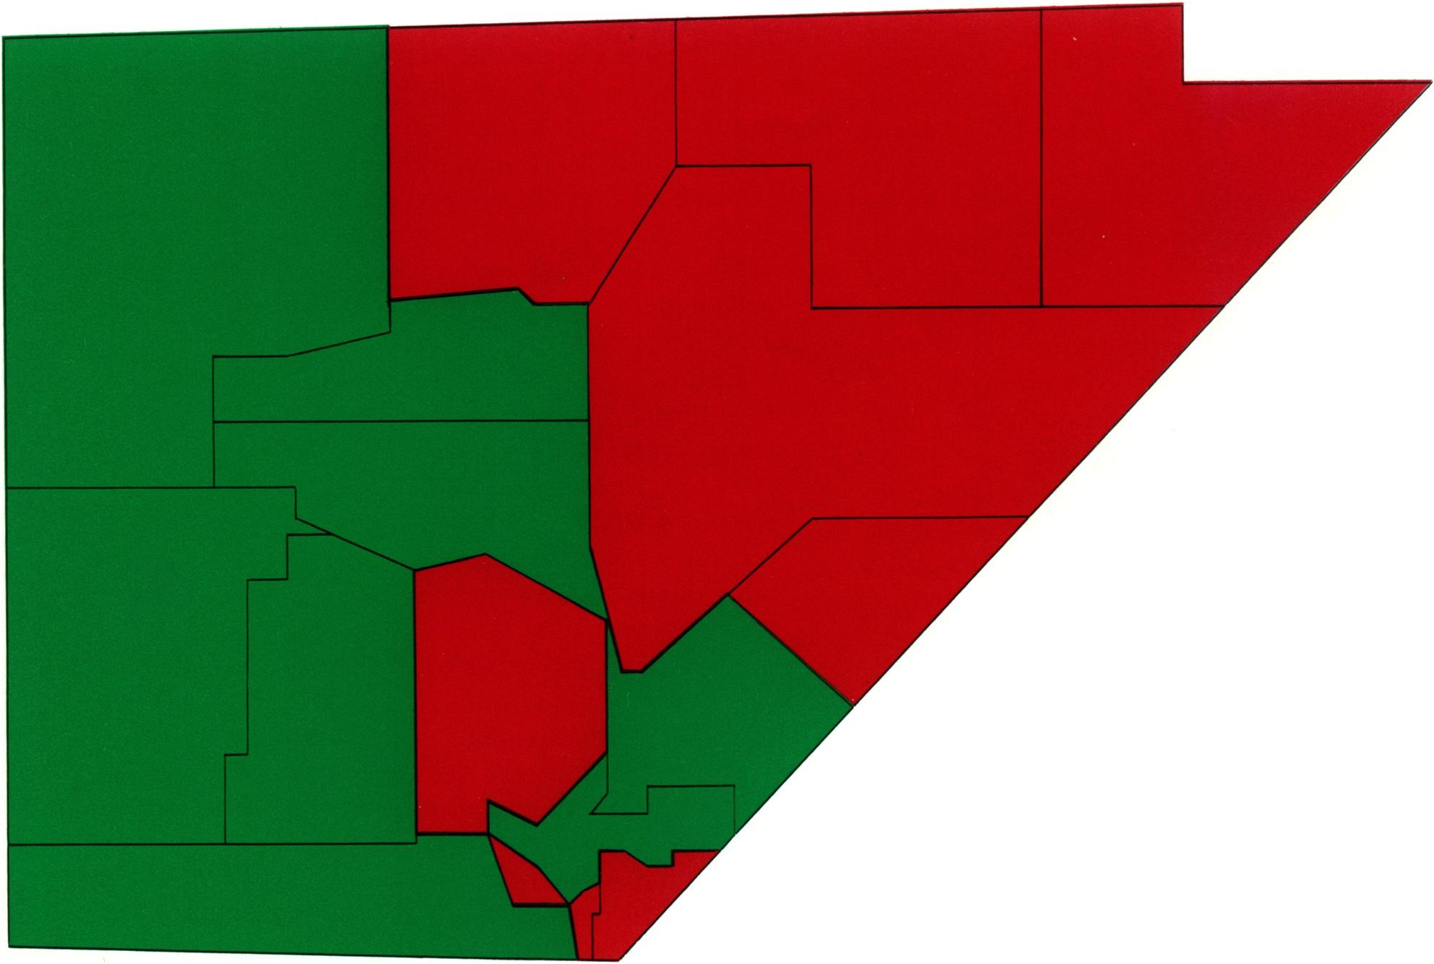
01:00
Color
Activity
Your Solution
Results from 1983 Experiment
The following map of Nevada has been colored to indicate various geological features in each county.
Estimate the larger land area-more red, more green, or the same-and mark your answer on the mentimeter poll in the next panel.
Please work fairly quickly, as if you were trying to gain an overall impression from a map.
28 / 34

Slide 29
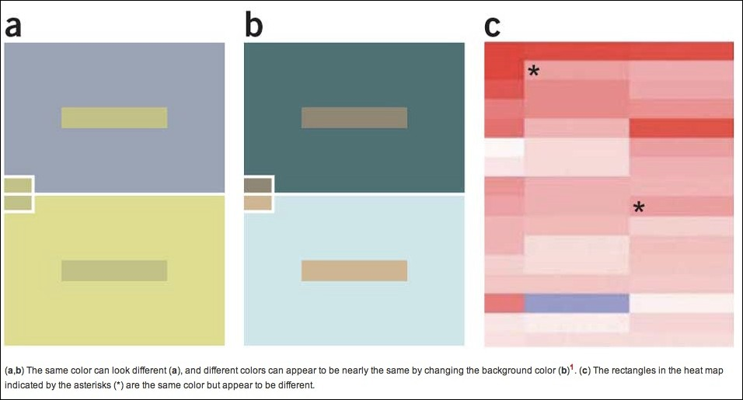
Simultaneous Contrast Affects Perception
Source: Slide Adapted from Hanspeter Pfister. Lecture Notes for CS 171. Harvard University. http://cs171.org/
29 / 34

Slide 30
Color Blindness
"About 1 in 12 men are color blind" -- NIH's At a glance: Color Blindness
Color Blindness Can Distort a Person's Reading/Interpretation of a Chart
Personal Check: To have a feel for color blindness (if you are not color blind), you can take this color blind test
Given the high prevalence of color blind individuals, your charts should accommodate for color-blindness. How?
Use color sparingly
Use color friendly palettes, e.g., see https://colorbrewer2.org/
30 / 34

Slide 31
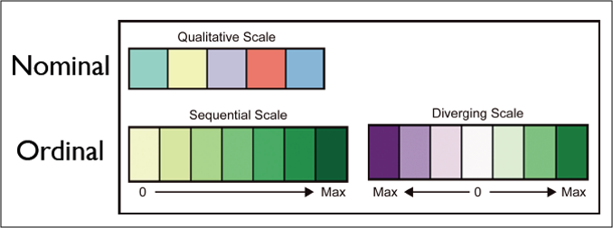
Color Brewer: Color Scales and their Selection
Source: Brewer, Cynthia A. “Color use guidelines for data representation.”Proceedings of the Section on Statistical Graphics, American Statistical Association. 1999.
31 / 34

Slide 32
RReeccaapp
3322 // 3344

Slide 33
Summary of Main Points
By now, you should be able to do the following:
Explain the concept of "graphical excellence"
Explain the theory of data graphics
Optimize visual encoding based on data types
Understand why color should be used sparingly and how to select appropriate colors (when color is a must)

Slide 34
Things to Do Prior to Next Class
Please go through the following two supplementary readings and complete assignment 08.
The Lie Factor and the Baseline Paradox; especially noting what the authors mean by "baseline", how the lie factor may be ignored in time-series applications, and/or in applications involving a "ratio" scale.
Useful junk? The effects of visual embellishment on comprehension and memorability of charts, which presents an experimental counter against Tufte's argument for simplicity (by quantifying vividness and recall of data from the more artistic charts). Note they define "ratio" different from how we have defined in class.

